Slide 1

Hospital Management System (HMS) Database Systems Project
Presented By: Rabeel Fatima (Sp23-BSE-032)
Course: Database Systems
Instructor: Sir Umar Rasheed
Date: 13-06-2025

Slide 2

Hospital Management System – Introduction & Objectives
1
Streamlined Operations
Automates patient, doctor, and appointment management.
2
Secure Access
Provides secure login for all admin and doctor
roles.
3
Automated Scheduling
Enables efficient appointment booking and approval.
4
Comprehensive Management
Handles medical records, billing, and real-time data.

Slide 3

Entities & Database Design
Patient: Name, Gender, Address, Password, Email
Doctor: Name, Email, Gender, Password, Specialization
Diagnosis: Diagnosis id, Patient ID, Doctor ID, Record ID, Condition, Medication, Surgeries
Medical Records: Patient ID, Doctor ID, Record ID, Condition, Medication, Surgeries
Bills: Patient ID, Amount, Payment Status
Appointments: Patient ID, Doctor ID, Appointment Date, Status
Users: Username, Password, Role (Doctor,Admin)

Slide 4



User Roles & Functionalities
Doctor
Admin
Manages diagnosis of patients and suggest medication and surgeries to patients.
Manages billing details ,adding doctors,patients,appointments,
medicalrecords(add, update, delete).
Doctors and admin can login and signup securely. They select their role during the process.

Slide 5
Forms, Buttons, and UI Controls
Users Form
Other Forms
UI Controls
Login, Signup, Exit
Add, Update, Delete, Exit
ComboBoxes (Gender, Role)
Delete, Update, Logout
Refresh, Search
Checkbox (Show/Hide Password)
Display for all entity data

Slide 6
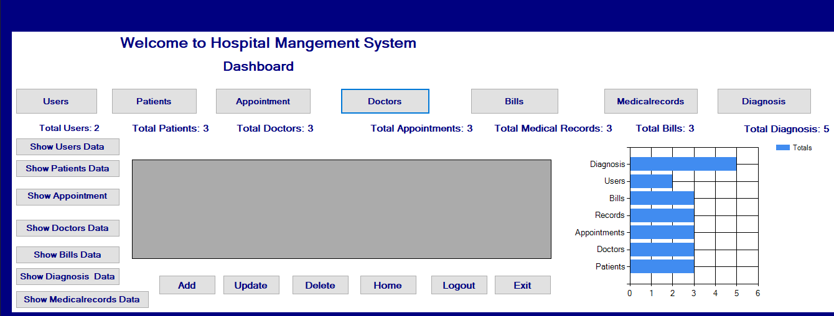
Dashboard:

Slide 7
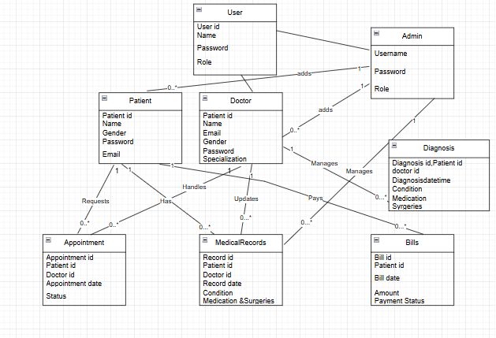
ERD OF HMS:

Slide 8

Conclusion
Secure & Efficient
User-Friendly
Manages hospital data with high security.
Role-based access ensures ease of use.
Real-time Insights
Technologies
Provides statistics and visual reporting.
Built with C# Windows Forms, ADO.NET, and SQL Server.

